Slide 1
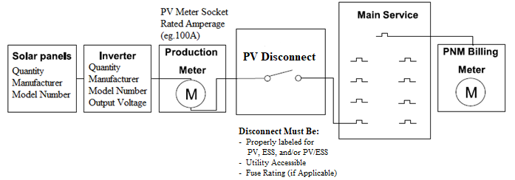
Info Box
Module(s): Quantity, Manufacturer, Model Number Inverter(s): Quantity, Manufacturer, Model Number *Calculations not required.
(If Applicable) Storage: Quantity, Manufacturer, Model Number CEC Certified Mode of Operation: i.e., Backup
One Line Diagram:
Back-Fed Breaker
REQUIRED FEATURES
Site Address (must match application)
STC Calculation box which contains the number of Modules and Inverters. If Energy Storage is applicable, the info box must include its output and mode of operation.
All equipment labelled with callouts, not in a legend, in correct order, and disconnect between inverter and interconnection point
If you are submitting an Expansion, please clearly label the equipment as New or Existing. Please also make this distinction in the Info box
Equipment Quantity, Manufacturer, and model number
Inverter Output Voltage
Production Meter Socket rated amperage (i.e 100A or 200A if system greater than 10kW AC) Note: neutrals cannot be bonded
All ESS must have UL9540 listing
All Inverters must have both UL1741 SB and IEE1547-2018 listings.
505 Camino de Solar Albuquerque, NM 87111
Components and connections shown are for illustrative purposes only
1. This illustrative sketch is not intended to specify utility interconnection or safety requirements.
2. PNM may request additional information if determined it is needed during the screening process.
3. This illustrative sketch is not intended to provide electrical design or code compliance directives.
4. Some components and connections shown may be internal to the inverter. The manufacturer and model number of the inverter must be shown on the drawing.
5. All switches, fuses, and mechanical interlock mechanisms which are part of the operating scheme to isolate the customers generating equipment from the utility during emergency
or maintenance conditions must be shown on the single-line diagram.
6. The narrative description accompanying the single line interconnection diagram must contain sufficient detail to determine if the components in, and the operation of, the
interconnection and protection systems meet the utility’s interconnection and safety standards.
Helpful Features
Voltage at point of Interconnection must match inverter output
If including a Generator or EV charger an NSD application must be submitted
Note: PNM may request additional information if
determined it is needed during the screening process

Slide 2
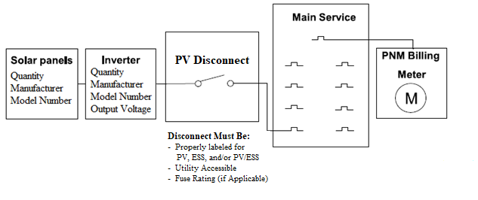
Info Box
Module(s): Quantity, Manufacturer, Model Number Inverter(s): Quantity, Manufacturer, Model Number *Calculations not required.
(If Applicable) Storage: Quantity, Manufacturer, Model Number CEC Certified Mode of Operation: i.e., Backup
One Line Diagram:
Back-Fed Breaker
For systems at or under 10kW AC
REQUIRED FEATURES
Site Address (must match application)
STC Calculation box which contains the number of Modules and Inverters. If Energy Storage is applicable, the info box must include its output and mode of
operation
All equipment labelled with callouts, not in a legend, in correct order, and disconnect between inverter and interconnection point
If you are submitting an Expansion, please clearly label the equipment as New or Existing. Please also make this distinction in the Info box
Equipment Quantity, Manufacturer, and model number
Inverter output Voltage
All ESS must have UL9540 listing
All Inverters must have both UL1741 SB and IEE1547-2018
505 Camino de Solar Albuquerque, NM 87111
Helpful Features
Voltage at point of Interconnection must match inverter output
If including a Generator or EV charger an NSD application must be submitted
Components and connections shown are for illustrative purposes only
1. This illustrative sketch is not intended to specify utility interconnection or safety requirements.
2. PNM may request additional information if determined it is needed during the screening process.
3. This illustrative sketch is not intended to provide electrical design or code compliance directives.
4. Some components and connections shown may be internal to the inverter. The manufacturer and model number of the inverter must be shown on the drawing.
5. All switches, fuses, and mechanical interlock mechanisms which are part of the operating scheme to isolate the customers generating equipment from the utility during emergency
or maintenance conditions must be shown on the single-line diagram.
6. The narrative description accompanying the single line interconnection diagram must contain sufficient detail to determine if the components in, and the operation of, the
interconnection and protection systems meet the utility’s interconnection and safety standards.
Note: PNM may request additional information if
determined it is needed during the screening process

Slide 3
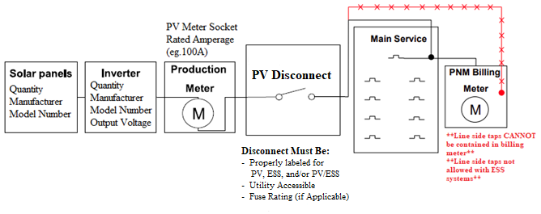
Info Box
Module(s): Quantity, Manufacturer, Model Number Inverter(s): Quantity, Manufacturer, Model Number *Calculations not required. *Line side taps not allowed with ESS systems
One Line Diagram:
Line Side Tap
REQUIRED FEATURES
Site Address (must match application)
STC Calculation box which contains the number of Modules and Inverters. If Energy Storage is applicable, the info box must include its output and mode of
operation
All equipment labelled with callouts, not in a legend, in correct order, and disconnect between inverter and interconnection point.
If you are submitting an Expansion, please clearly label the equipment as New or Existing. Please also make this distinction in the Info box
Equipment Quantity, Manufacturer, and model number
Inverter output Voltage
Production Meter Socket rated amperage (i.e 100A or 200A if system greater than 10kW AC) Note: neutrals cannot be bonded
All Inverters must have both UL1741 SB and IEE1547-2018
Line side taps are not allowed with ESS systems
505 Camino de Solar Albuquerque, NM 87111
Note: PNM may request additional information if
determined it is needed during the screening process
Components and connections shown are for illustrative purposes only
1. This illustrative sketch is not intended to specify utility interconnection or safety requirements.
2. PNM may request additional information if determined it is needed during the screening process.
3. This illustrative sketch is not intended to provide electrical design or code compliance directives.
4. Some components and connections shown may be internal to the inverter. The manufacturer and model number of the inverter must be shown on the drawing.
5. All switches, fuses, and mechanical interlock mechanisms which are part of the operating scheme to isolate the customers generating equipment from the utility during emergency
or maintenance conditions must be shown on the single-line diagram.
6. The narrative description accompanying the single line interconnection diagram must contain sufficient detail to determine if the components in, and the operation of, the
interconnection and protection systems meet the utility’s interconnection and safety standards.
Helpful Features
Voltage at point of Interconnection must match inverter output
If including a Generator or EV charger an NSD application must be submitted

Slide 4
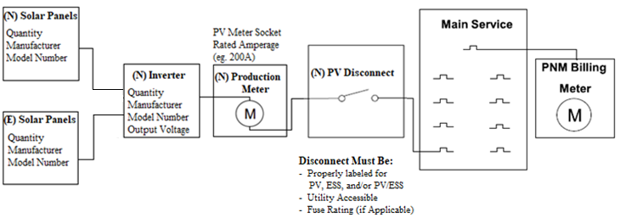
Info Box
Existing (E) Module(s): Quantity, Manufacturer, Model Number Inverter(s): Quantity, Manufacturer, Model Number New (N) Module(s) Quantity, Manufacturer, Model Number Inverter(s): Quantity, Manufacturer, Model Number *Calculations not required. *Line side taps not allowed with ESS systems
(If Applicable) Storage: Quantity, Manufacturer, Model Number Mode of Operation: i.e., Backup
One Line Diagram:
An Expansion example
REQUIRED FEATURES
Site Address (must match application)
STC Calculation box which contains the number of Modules and Inverters. If Energy Storage is applicable, the info box must include its output and mode of
operation
All equipment labelled with callouts, not in a legend, in correct order, and disconnect between inverter and interconnection point
If you are submitting an Expansion, please clearly label the equipment as New or Existing. Please also make this distinction in the Info box
Equipment Quantity, Manufacturer, and model number
If V2G functionality is desired, EV charger must be depicted in diagrams and application.
Inverter output Voltage
Production Meter Socket rated amperage (i.e.100A or 200A if system greater than 10kW AC) Note: neutrals cannot be bonded
All ESS must have UL9540 listing
All Inverters must have both UL1741 SB and IEE1547-2018
505 Camino de Solar Albuquerque, NM 87111
Helpful Features
Voltage at point of Interconnection must match inverter output
If including a Generator or EV charger an NSD application must be submitted
Note: PNM may request additional information if
determined it is needed during the screening process

Slide 5
Future Information
• For 3-phase systems Three Line Diagram is required
• A Three-line diagram may be requested be reviewers as deemed necessary.
• For Large (>10 kW AC) and/or 3-phase systems:
• Please include reference to PNM Meter Standard
• Production meter Socket must be rated at least 200A
• For Battery Backup or Energy Storage Systems, please refer
to PNM Interconnection and Safety Standards as well.
• All diagrams are evaluated to ensure compliance with PNM metering and Interconnection and Safety Standards. This evaluation does not imply NEC compliance.
• For Interconnection and Safety Standards, please visit
• https://www.pnm.com/interconnecting-small-facilities
• https://www.pnm.com/interconnecting-large-facilities
• For technical requirements for interconnecting Distributed Energy Resources (DER) to PNM’s
electric distribution system please see PNM’s Technical Interconnection and Interoperability
Requirements (TIIR)
    PNM Technical Interconnection and Interoperability Requirements

